Slide 1
Virginia Nursing Students’ Association

Slide 2
2022 Council of Student Leaders’ Summit
November 12, 2022
Notes:
Missing
Graduate consultant

Slide 3
What is COSL?
COSL stands for the Council of Student Leaders. This an annual meeting in which the Virginia Nursing Students’ Association (VNSA) invites any nursing students from Virginia to network and collaborate with the Board of Directors. We invite everyone to see how VNSA runs their meetings and so that we can collaborate with the local chapters. We are highly interested in knowing what is going well and what isn’t for the local chapters!
Notes:
Hannah

Slide 4
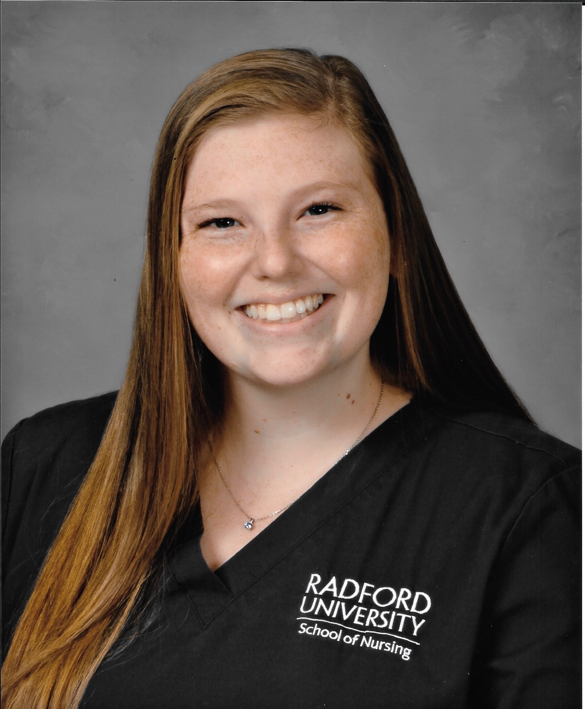
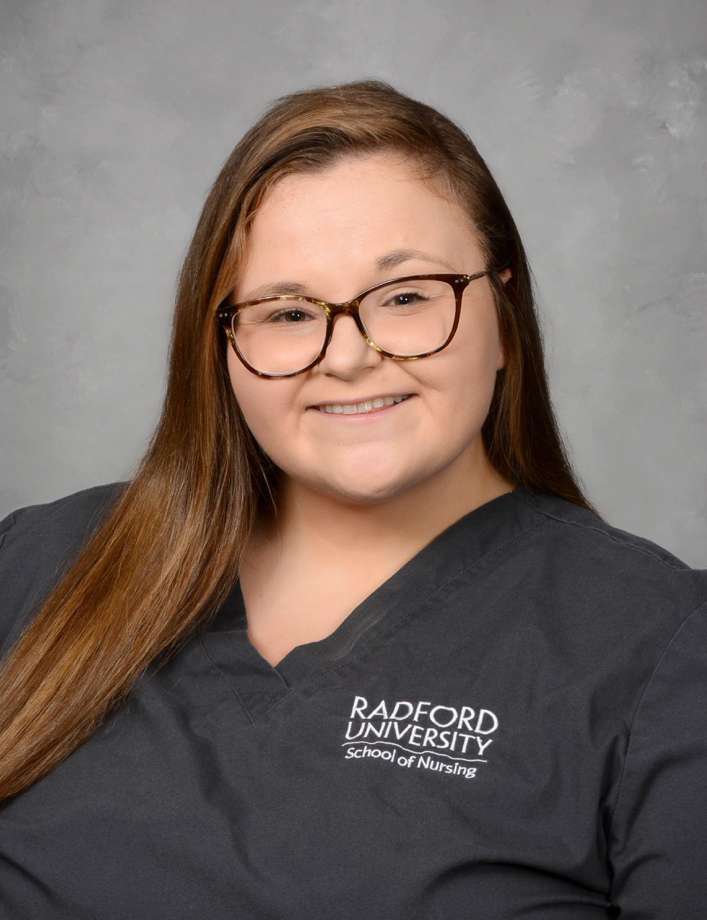
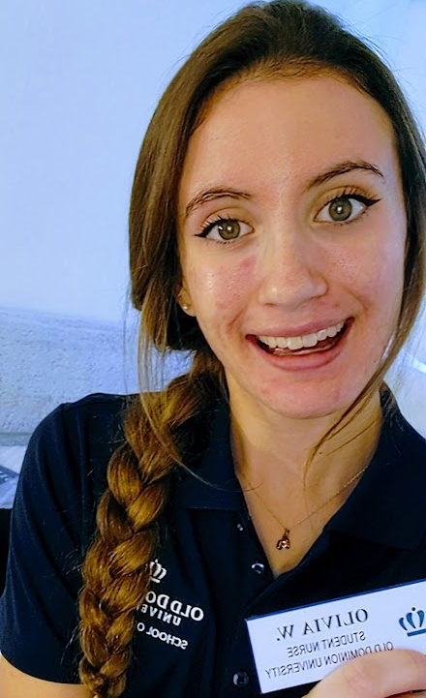
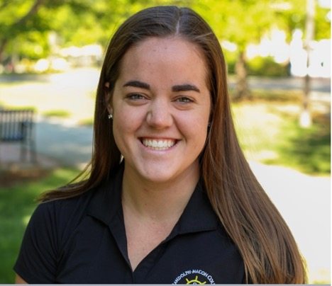
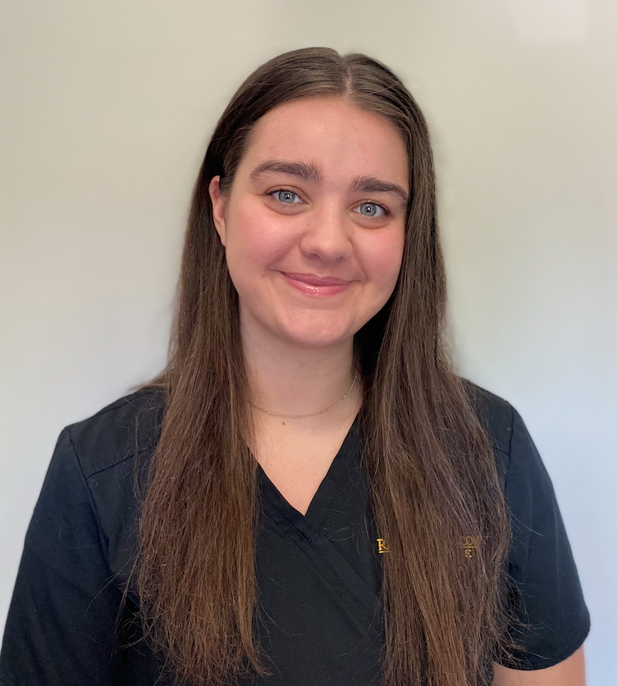
Meet the Board
Vice Presidents
President
Breakthrough to Nursing Director
Treasurer
Secretary
Historian
Hannah Moody
Taylor McCaleb
(First VP)
Lilly Bull
(Second VP)
Addison Wallace
Olivia Winfield
Katie Herzberger
Emma LeBlanc
Notes:
Add picture of self

Slide 5
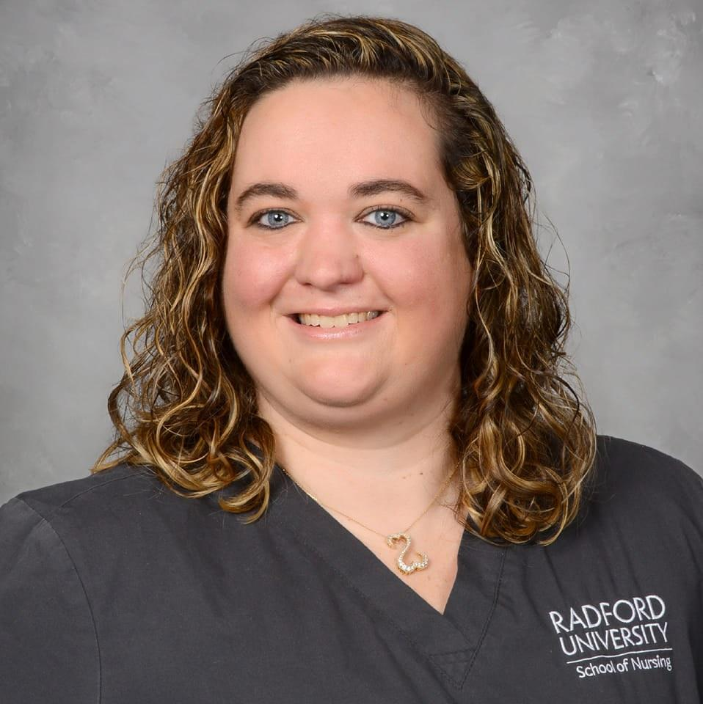
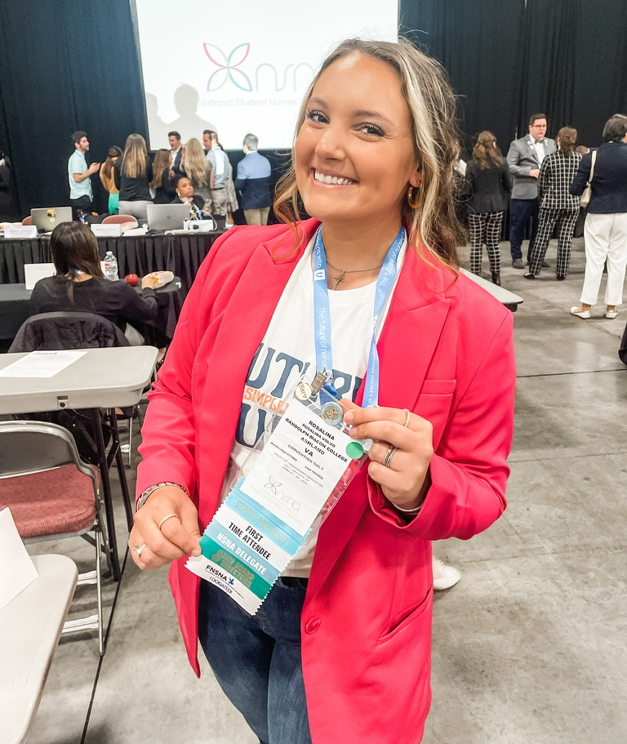
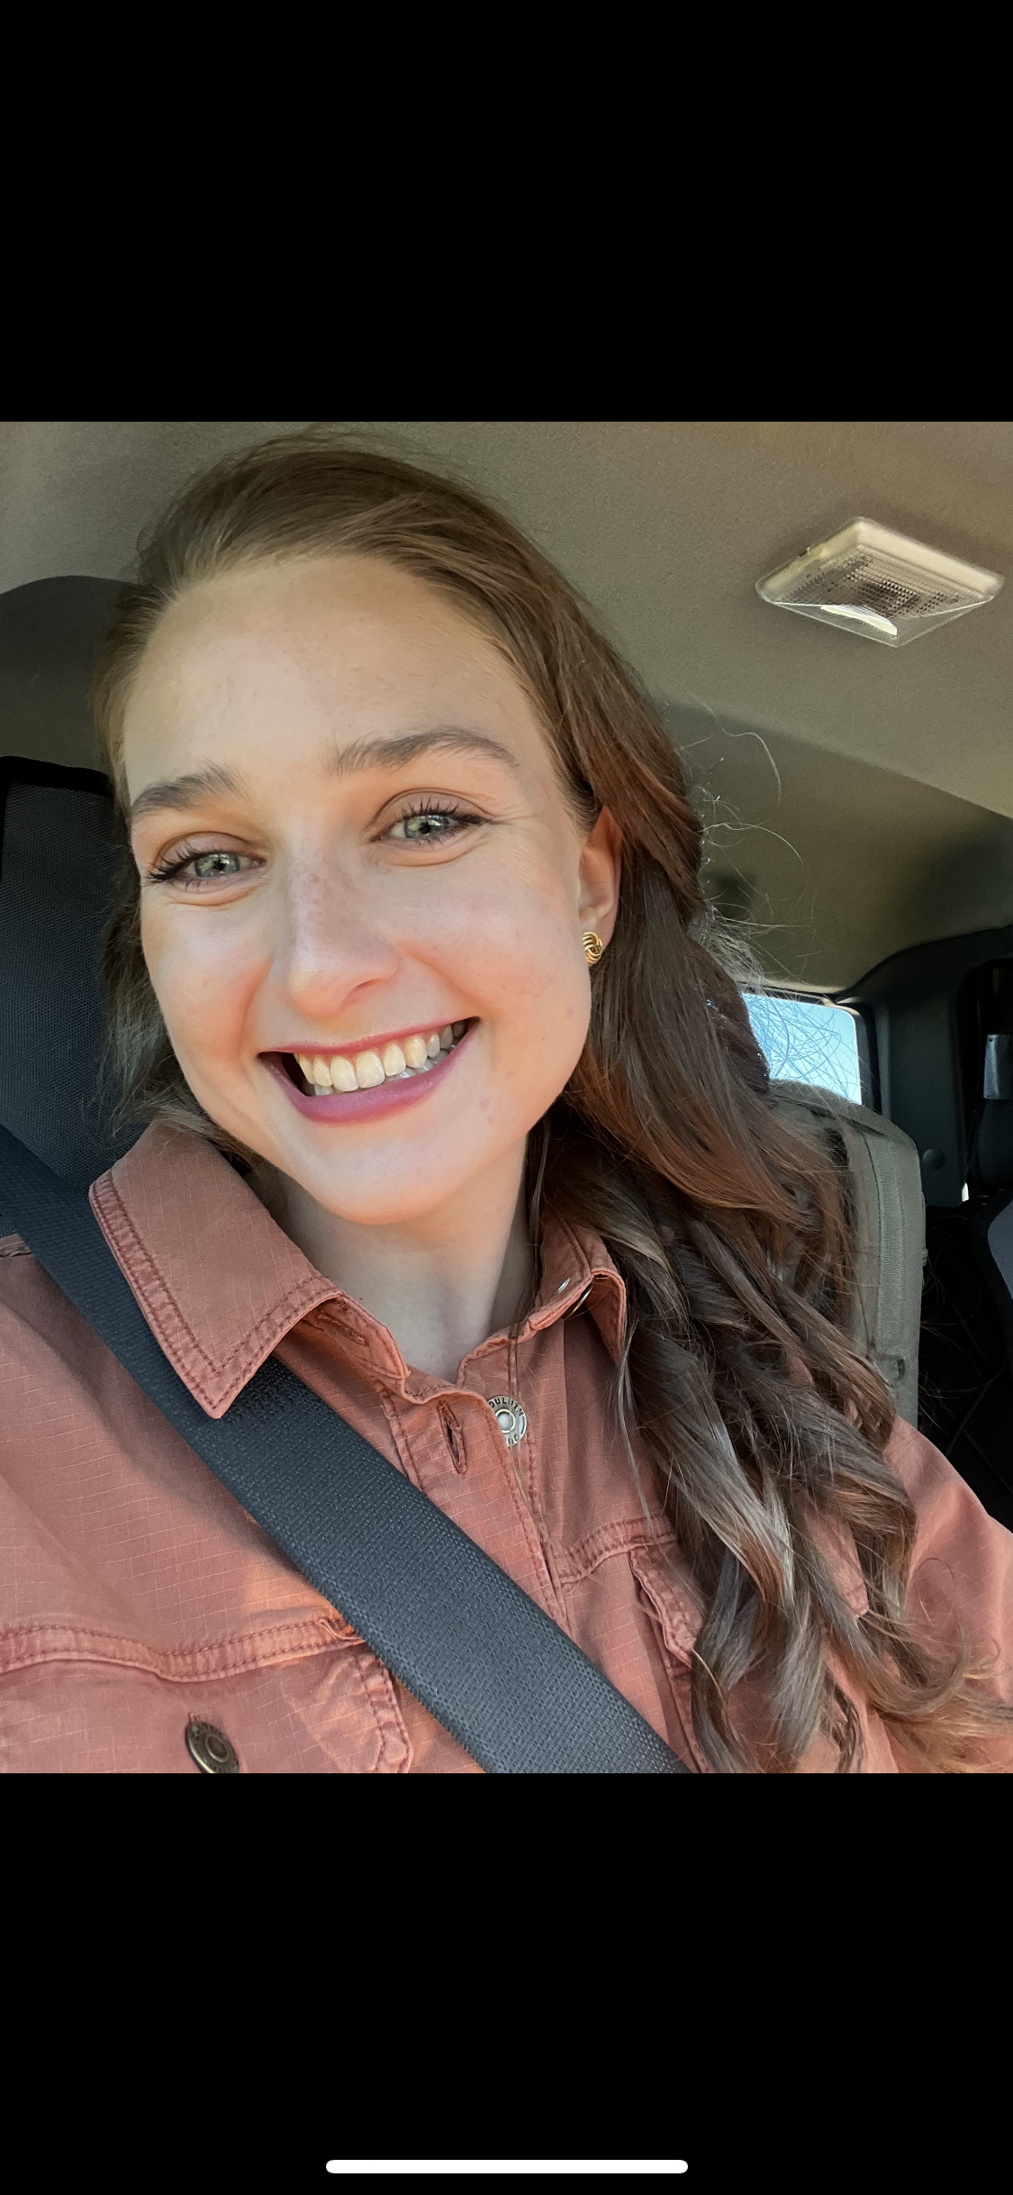
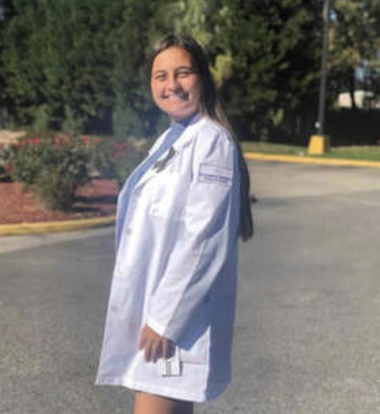
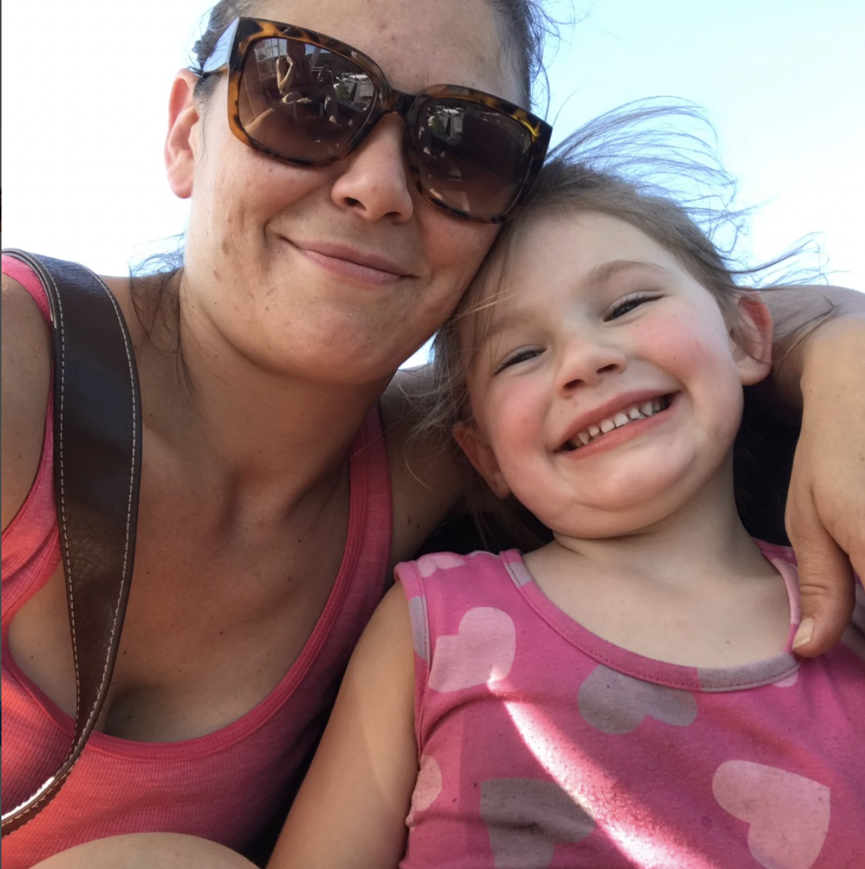
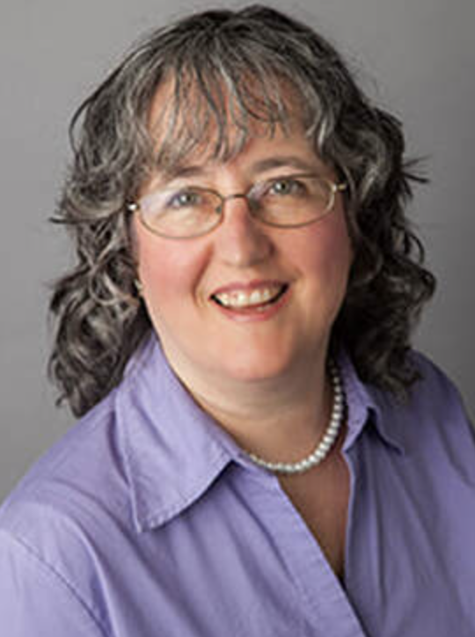
Director at Large
Nominations and Elections Chair
Policies and Initiatives Director
Graduate Advisor
VNSA Consultant
VNSA Advisor
Josie O’Dell
Rosalina Volo
Gabby Crouch
Brianna Kimes
Rebecca Conte
Sandra Annan
Notes:
Everyone introduces themselves

Slide 6
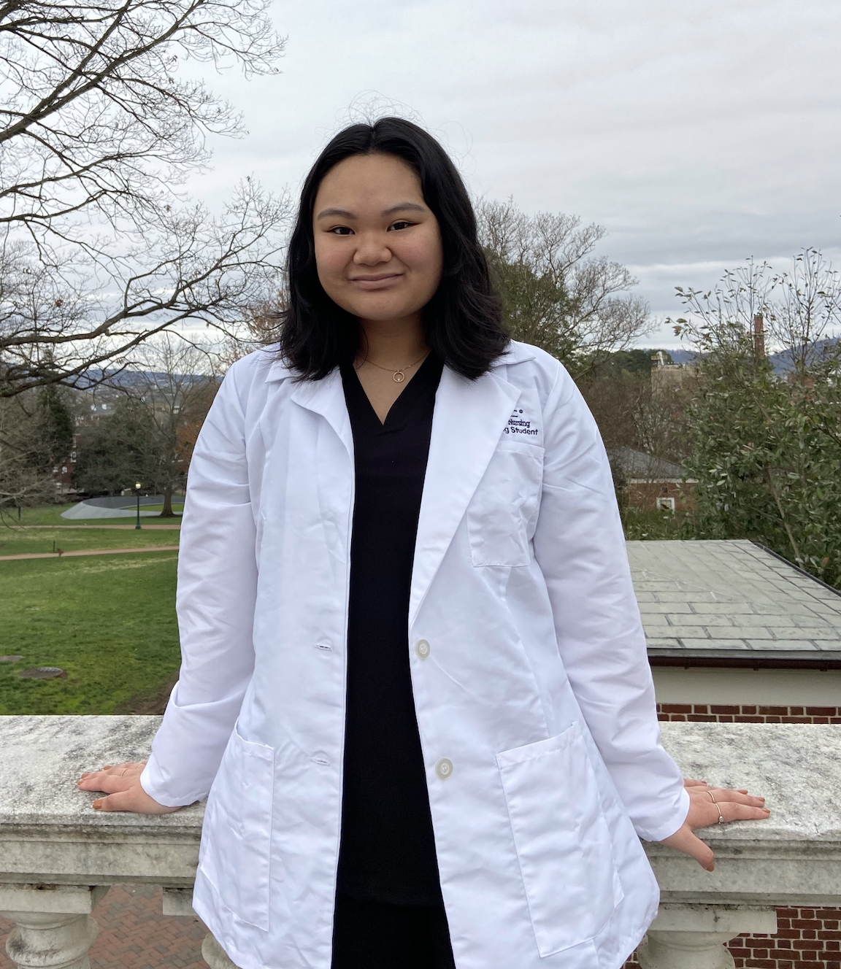
About Me: President
Hi all!
My name is Hannah Moody (hlm6dkc@virginia.edu), and I’m a nursing student at the University of Virginia!
I am in my third year BSN graduating May of 2024.
I’m from the Richmond area which actually means Chester, but no one knows where that is haha!
I currently aspire to specialize in either nurse anesthesia or possibly surgical-trauma critical care.
I’m passionate about increasing diversity and inclusiveness for underprivileged individuals of all races, sexualities, social classes, etc.

Slide 7
President Responsibilities
Preside over all general body meetings and ensure that board members are progressing on their respective duties in preparation for the Council of Student Leaders Summit (COSL) and the annual state convention
Work closely with board members as needed to provide information and support for each of their various roles
Public face for VNSA as needed, such as in attendance for the National Student Nurses’ Association annual conference
Work in collaboration with the vice presidents to network with potential individuals who are interested in the opportunity to pass knowledge onto prospective nursing students
Work closely with the treasurer to budget events and allocate funding to events
Management of VNSA communications within VNSA faculty, NSNA, and local Virginia chapters

Slide 8
NSNA Board of Directors
As you may know, state and local chapters model their associations after the National Student Nurses’ Association!
Any NSNA member can run from any local chapter as pre-slated candidates until January 17th, 2023 for approval by the national Nominations and Elections board
There are a variety of positions that we will outline in this powerpoint that mimics the duties and responsibilities of those on NSNA
Benefits of becoming a member board member of either association include but are not limited to: leadership skills, communication enhancement, resume building, and networking through opportunities such as being funded to attend conferences across the country! .
Go big or go home! Think about being a board member of NSNA, but please consider VNSA first!!!!
https://www.dropbox.com/scl/fi/dfyguv5hawsofmn0sod9v/NEC-Leadership-2021.pptx?dl=0&rlkey=yo7m8m81dz9xkpks00pewxgep
Notes:
Need to review if information is correct

Slide 9
Ice Breaker: Two Truths and a Lie!!!
As we go through each person’s two truths and a lie, please keep track of the number of lies you get correct about a person!
We will have a prize for the person with the most correct answers!

Slide 10
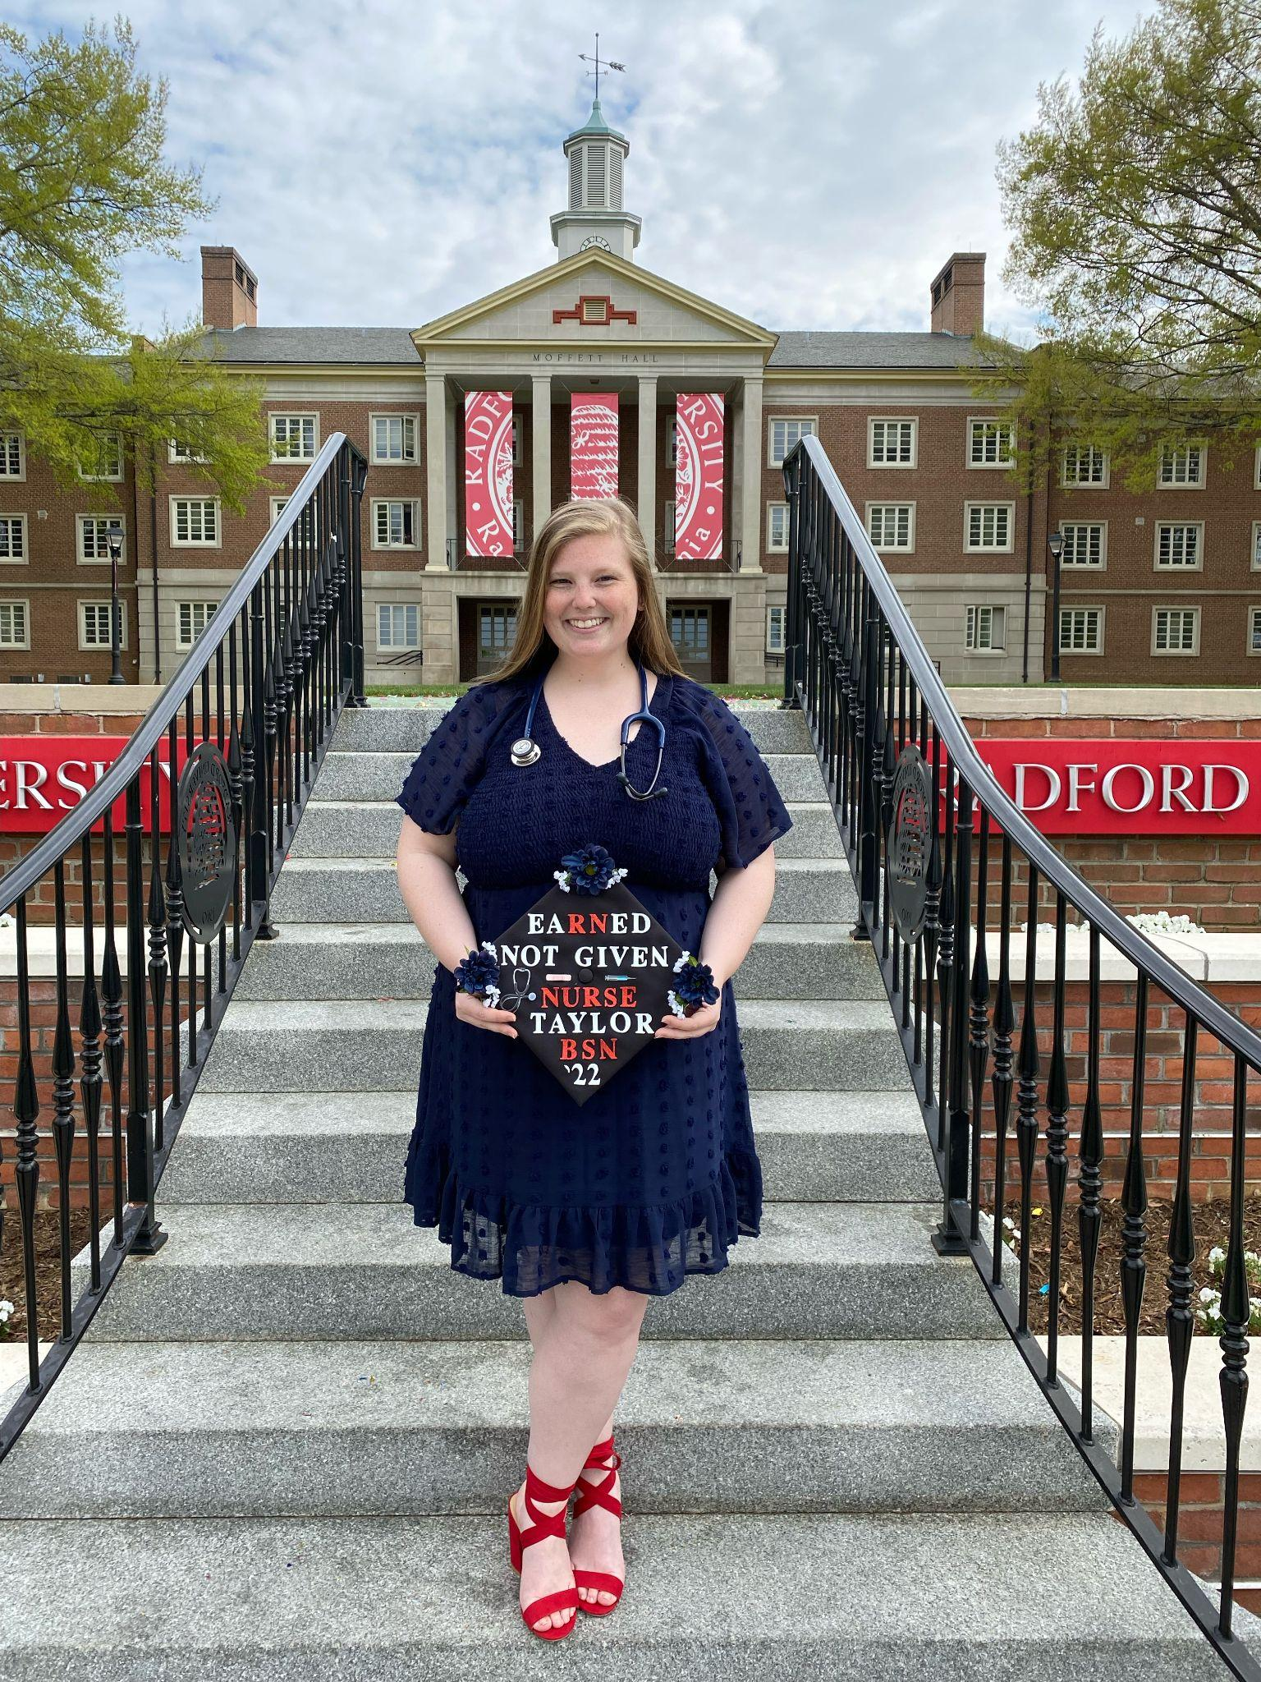
First Vice President–Taylor McCaleb
About Me!
I’m from a small town in south west Virginia called Craig Country.
I am a recent May 2022 graduate from Radford University’s School of Nursing.
When I was at Radford, I served as my local student nursing organization’s historian for two semesters.
I currently work as a Med Surg nurse at Lewis Gale Medical Center in Salem, Virginia.
I plan to continue my education to one day teach nursing. Teaching is a passion of mine!

Slide 11
First Vice President
Roles and Responsibilities
Chair person in charge of planning the annual VSNA convention
Determine a theme, location, and date of convention to be voted on during monthly meetings
Collect ideas for speakers during the convention
Lead communicator between VSNA and potential speakers for convention
Make a schedule for convention
Make an enticing flyer to promote the convention
Collaborate with colleagues and organize details of convention
Fill in roles and responsibilities of the president in their absence

Slide 12
Convention February 2022 Updates!
Theme: Nursing = LeaRNing
Date: unknown, sometime in February
Location: University of Virginia, UVA
Potential Speakers:
List of potential speakers made on a shared google document
Keynote/Endnote: reaching out to deans of UVA to feel out interest, no answer yet
DNP: reached out to two Radford University Professors to feel out interest in speaking
Tentative Schedule made
Flyer promoting convention made, sparing our finalized details

Slide 13
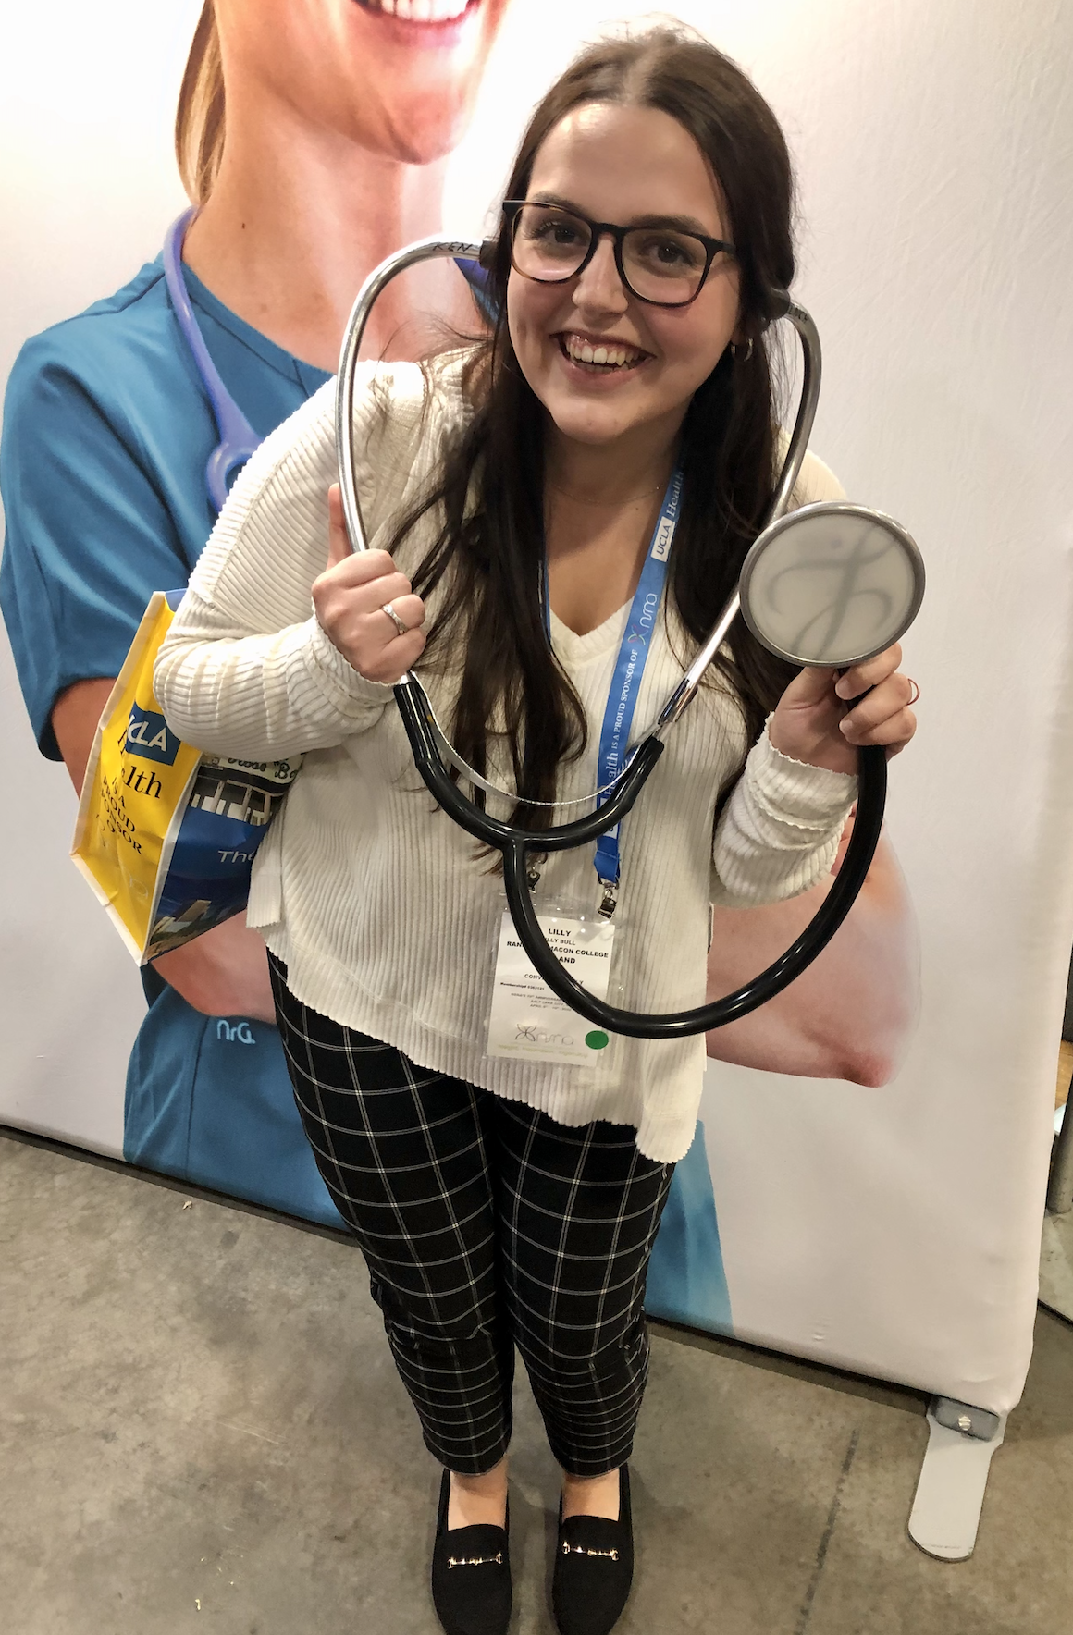
Second Vice President - Lilly Bull
A little about me:
I am from Southern Maryland, just outside of DC!
I am a Junior at Randolph-Macon College, in Ashland, Va.
At RMC, I serve as our SNA 2nd Vice President.
I currently work as a Nurse Extern on an ICU in Richmond!
I am not fully sure what type of nursing I want to do post-graduation, however I am interested in critical care. I plan to eventually go back to school to earn my NP!
Outside of nursing I enjoy other school activities such as my sorority and intramural sports.
My hobbies include cooking and reading!

Slide 14
Second Vice President
Roles and Responsibilities
Be responsible for reviewing and recommending changes to the Bylaws.
Notify constituents that they are required to submit annually the official application for NSNA Constituency Status, and that the deadline by which they are required to submit their bylaws is the beginning of the House of Delegates meeting at the VNSA yearly convention (Article III, Section 3.01e).
Review individual constituent associations' bylaws and determine their conformity with the four areas of conformity listed in Article III, Section 3.01e. If any discrepancies are noted, the Second Vice President is responsible for notifying the constituent of the necessary revisions.
Maintain files, which include the names and addresses, of all constituent associations and their officers.
Maintain the current NSNA membership list.
Serve as a resource person regarding parliamentary procedures.
Accede to the office of the First Vice President in the event of vacancy in the office.
Perform all other duties as assigned by the President.

Slide 15
Scholarship Opportunities:
VNSA offers scholarship opportunities for students involved!
These scholarships will be awarded to students during our VNSA Annual Convention in February
Application Deadline: January 6th at Midnight
Scholarship Awards:
Nursing Student of the Year
Most Active Constituency
VNSA Scrapbook Contest
Excellence in Nursing Instruction Award
Most Outstanding Community Service Award
Most Supportive Faculty Member
Notes:
lilly

Slide 16
Award Opportunities:
VNSA offers awards for students, faculty, and constituencies involved!
Awarded to students during our VNSA Annual Convention in February
Nomination Deadline: January 10th at Midnight
Scholarship Awards:
VNSA Single Parent Scholarship
VNSA Second Degree Student Scholarship
VNSA Traditional Nursing Student Scholarship
VNSA Community College Scholarship
Notes:
lilly

Slide 17
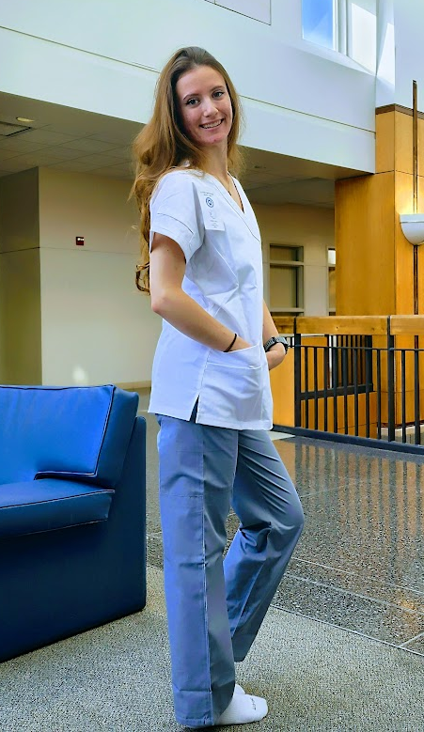
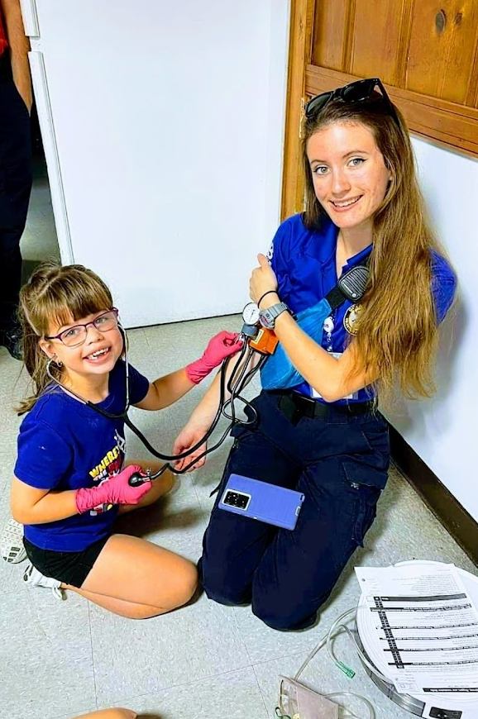
Secretary - Olivia Winfield
About Me!
I am a 3rd-year BSN, RN nursing student at Old Dominion University
I volunteer as an Emergency Rescue EMT for the City of Virginia Beach
Previously served as the VNSA pre-nursing liaison for 2021-2022
I currently work as a full-time nanny
Interested in pursuing Labor & Delivery Nursing, and possibly Midwifery
Hobbies: Rock climbing, motorcycles, hiking/backpacking, gym
Thank you!

Slide 18
Secretary
Roles and Responsibilities
Shall record and distribute the minutes of all meetings of this association as directed by the President.
Shall keep on file as a permanent record all reports, papers and documents submitted to the secretary.
Refer to duly appointed committees the necessary records for the completion of business.
Forward minutes to the national student nursing association board as well as the names and addresses of all officers and committee chairpersons after their election or appointment.
Deliver to the newly elected Secretary all association papers.
Have fun!

Slide 19
Ice Breaker: Guess who?
Each person will get a name tag that they will not know the identity of
The goal is the ask “yes or no” questions to figure out your identity!
First person to figure out their identity will receive a prize

Slide 20
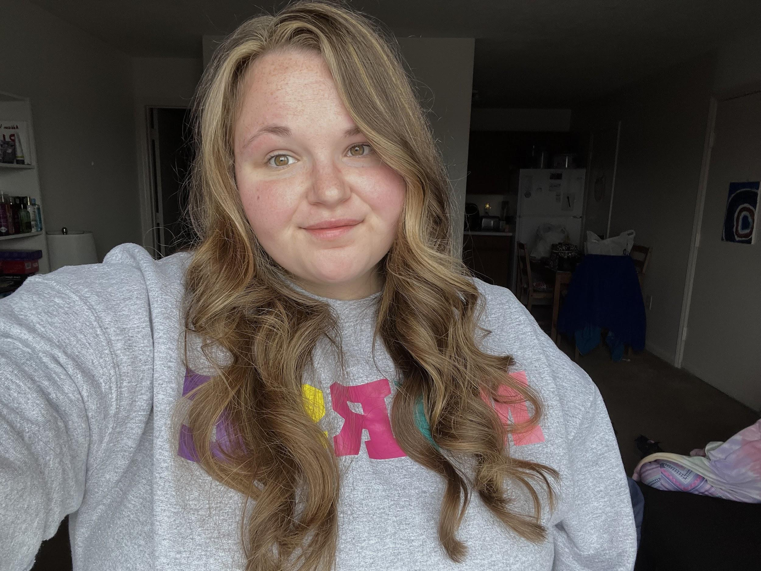
Treasurer
About Me!
From the Eastern Shore of VA
Senior Nursing major at Radford University
Obtained a bachelor's degree in Psychology in May 2022
Have accepted a job on the mother/baby unit at Carilion Roanoke Memorial Hospital in Roanoke VA
Future goals: pediatric psychiatric nurse
Notes:
Get-to-know-you slide
Position duties and responsibilities
Budget report
Treasurer workshop
Pick a topic to discuss
Examples
What is a Total School Membership Plan?
A way for nursing programs to register all of their students as an NSNA member in one bulk payment

Slide 21
Treasurer - Position Duties
Act as custodian of association funds
Be bonded and co-sign checks with the President for monetary disbursements
Keep accurate, current financial files, make regular reports to the VNSA and let any member of the VNSA see these upon request
At the end of the fiscal year, obtain a CPA, approved by BOD, to conduct a review of the records
Compile a report to present at the annual convention
Handle dues and other money transactions for the membership according to the procedure designated by NSNA
Distribute reimbursements to the board after receiving documentation of use with statements and receipts
Be responsible for monitoring VNSA credit cards. All use must be approved by BOD
Prepare an estimated fiscal budget
Serve as chairperson of the Finance Committee, when it is established by BOD

Slide 22
How To: Budget Reports
Information You Need
Type of event
Estimated number of people at event
Are you providing food?
Are you providing incentives?
Tote bags
T-shirts
Cups
Hotel costs
Where is it being held?
Is there a fee for holding it there?
Speakers
Are you providing gifts for them?
Online registration fee if applicable (we use CVENT)

Slide 23
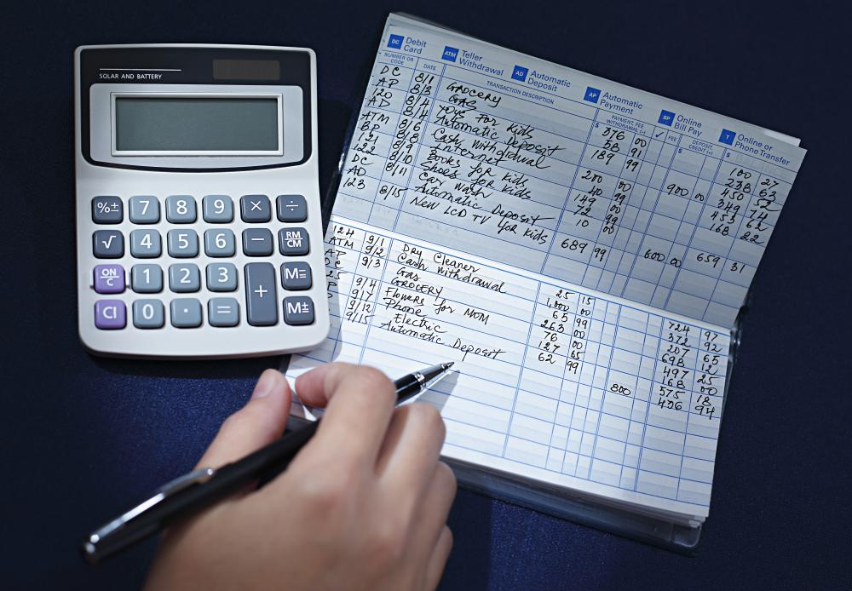
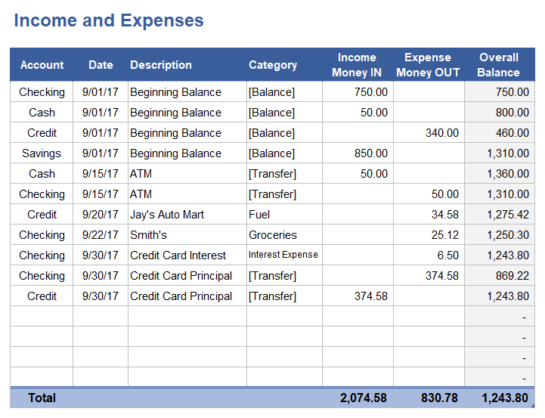
Treasurer Workshop:
How to easily keep track of expenses/deposits
NO
YES

Slide 24
Why You Should Use an Excel Spreadsheet
Easier to keep track of
More organized
Easier to transfer to each treasurer every year (especially if it on Google Sheets)
Easy How To: Step-By-Step How to Make a Budget in Google Sheets (Step by Step) (tillerhq.com)

Slide 25
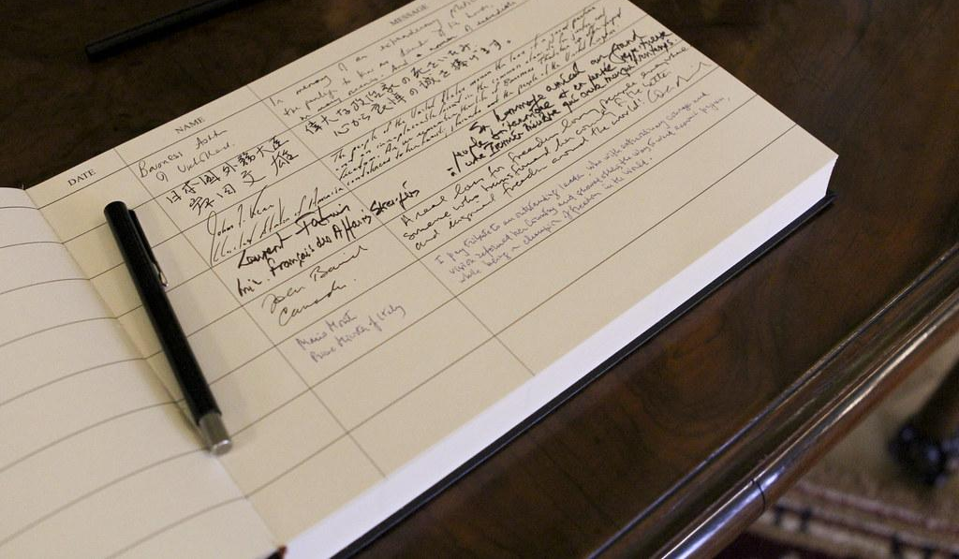
Why You Shouldn’t use a Transaction/Check Register Book
Might be hard to read
Easier to misplace
Easier to make mistakes on it
Not a lot of room to write

Slide 26
2022-2023 Budget Report
Credits
Amount | Reason
$9,060 | National Student Payments
$1,998.15 | CVENT Inc
$400 | Convention Exhibitor
$500 | Misc.
Total: | $11,958.15

Slide 27
2022-2023 Budget Report
Debits
Amount | Reason
$719.01 | Travel Reimbursement (Checks only)
$285 | Storage Unit
$5,278.34 | PayPal Transactions (R.C Payroll and Travel Reimbursements)
$99 | Broadcast Blast Email
$100 | VNSA Gifts
$2,810.85 | Hotels/Flights/Food
$96 | Weebly
$5,875 | CVENT
Total: | $15,263.20
Notes:
Difference of -$3,278.05

Slide 28
Ice Breaker: Race to the Truth
Each person will start on a line while each person takes a turn stating a true but general fact about themselves.
Example: I have a dog
If the stated fact is true for any, those individuals must move forward a step
Whoever crosses the finish line first wins a prize!

Slide 29
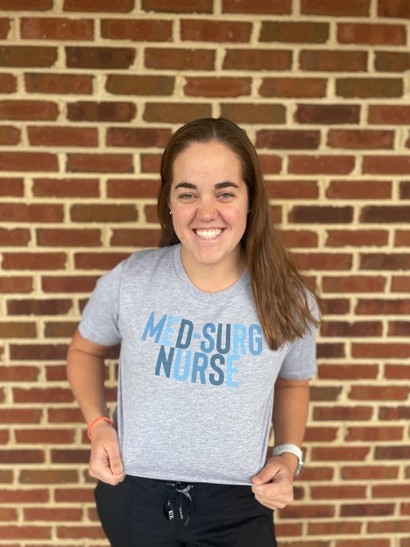
Historian: Katie Herzberger
About Me:
I am originally from New York, but now live in Greensboro, NC
I am currently a senior nursing student at Randolph-Macon College
I work as a Nurse-Extern on the Surgical Care unit at my hospital and accepted a position a RN position on that unit:)
I am on my college swim team and in Greek Life
My favorite thing to do outside school is go to the beach and skydiving

Slide 30
Historian: Roles and Responsibilities
Attend all VNSA events and documents events through photography. Events include but are not limited to State Convention, National Convention, luncheons, board meetings and activities
Collaborate with Public Relations and The Torch of the Union Editor pertaining VNSA publications
Make a yearly scrapbook, which will be available for the view of the Spring Convention
Contribute to archives of VNSA, including contributing to historical documentation of VNSA board members, pictures and events
Be responsible for awards list for annual convention with the assistance of the other board members as designated by the President

Slide 31
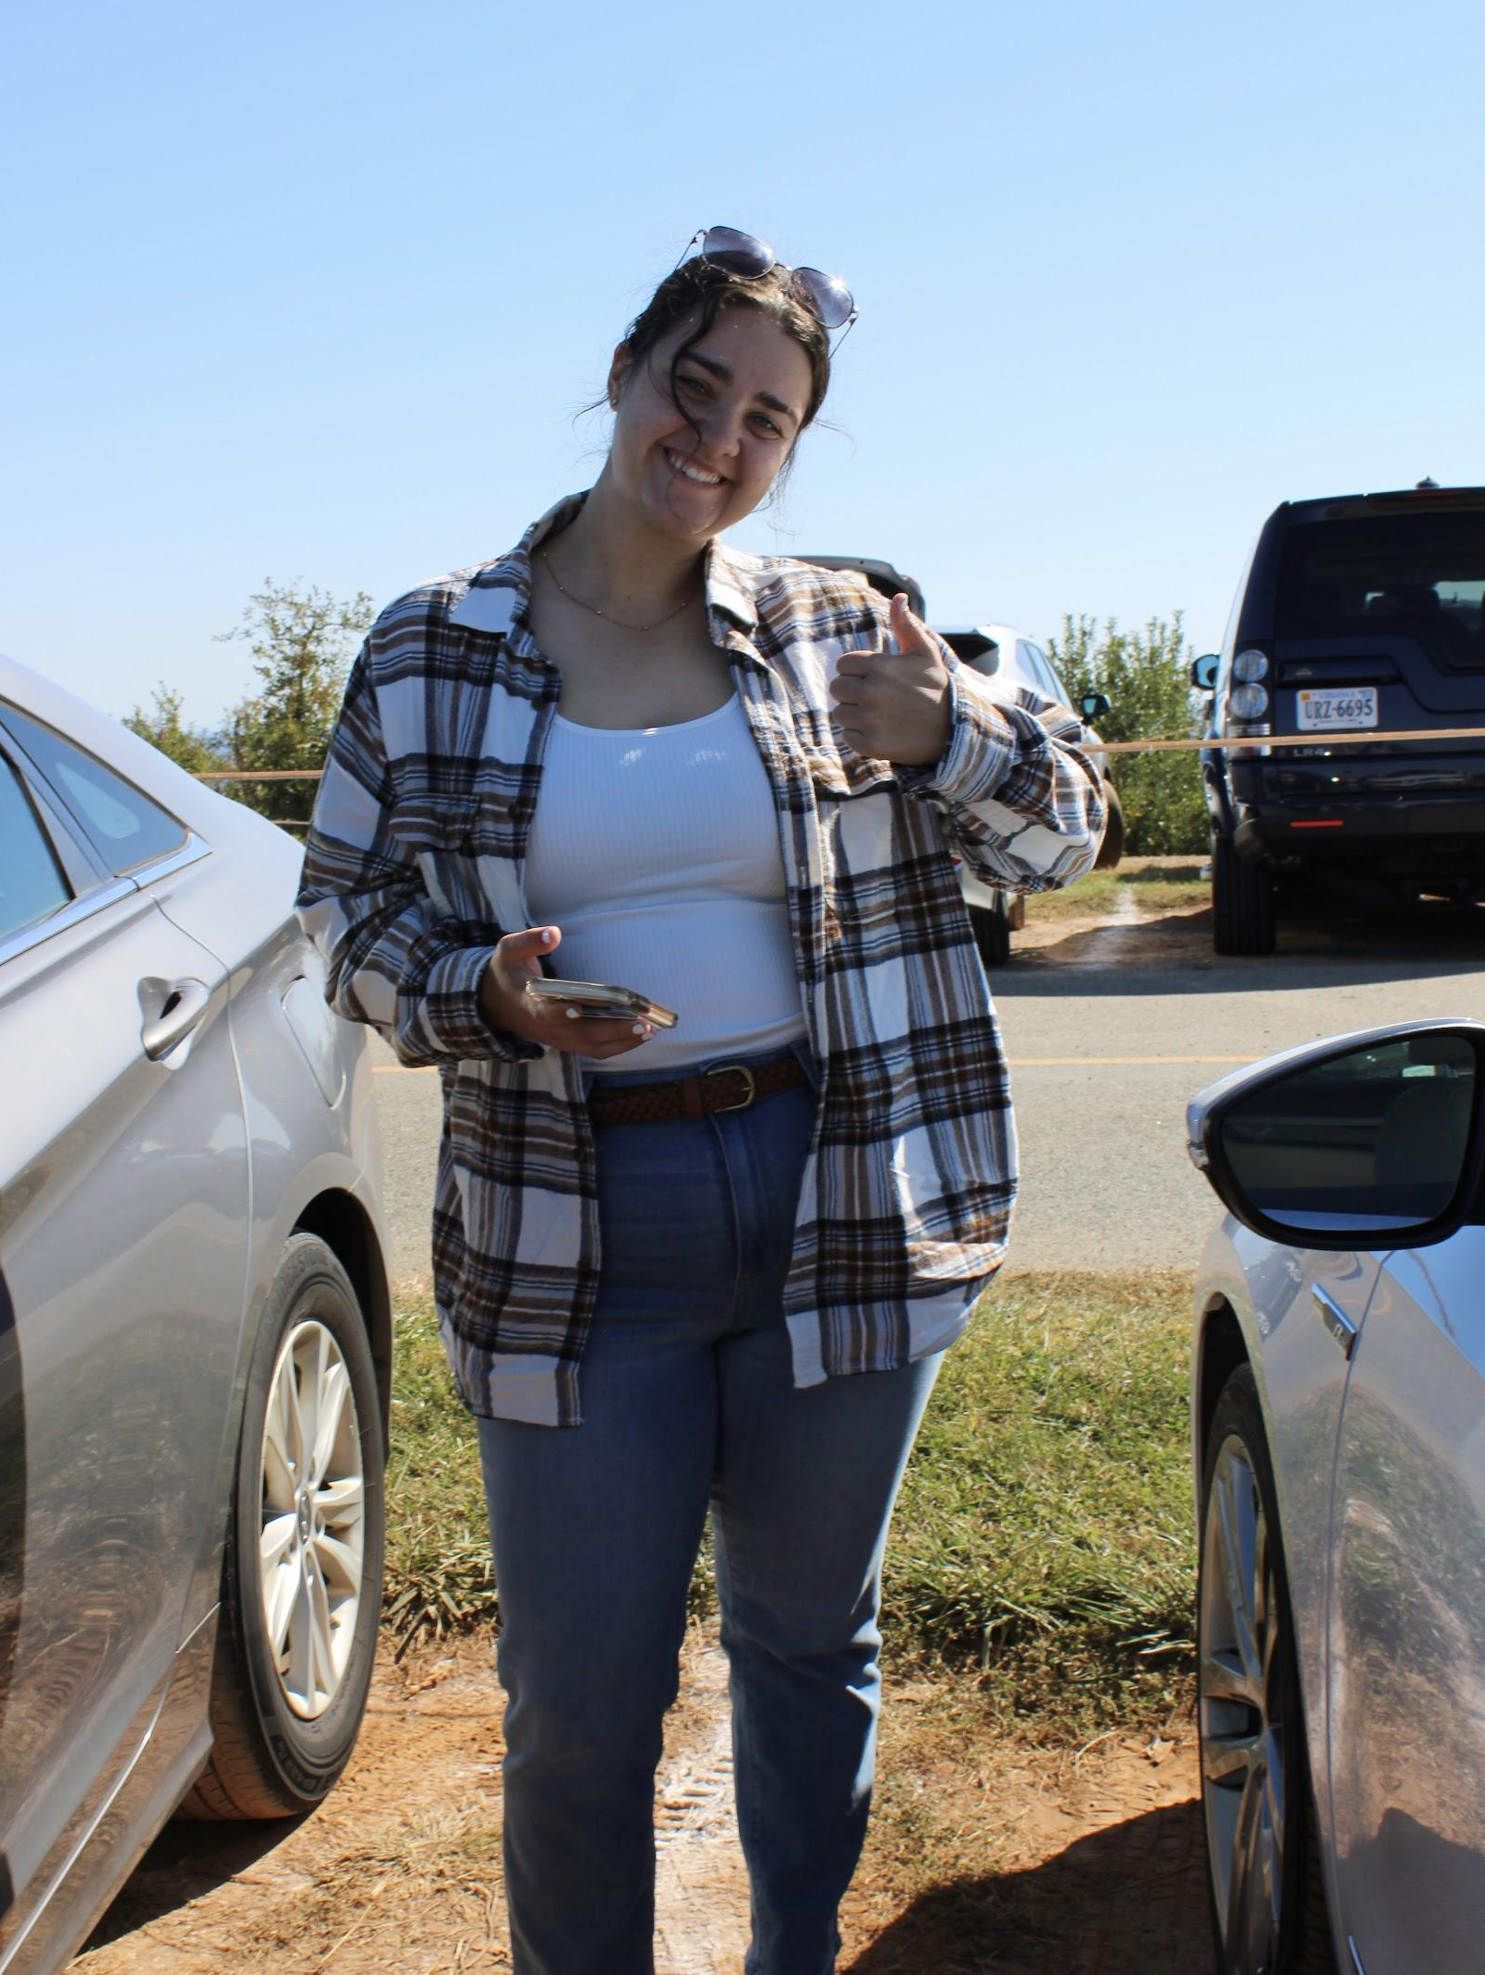
Breakthrough to Nursing - Emma LeBlanc
About Me
I’m from Boston, MA, but I currently live just outside of Chicago, IL
I am a current senior at Randolph-Macon College
I currently work as a Pediatric Nurse Extern and hope to continue as a pediatric nurse post-grad
I also work as an athletic training work study where I get to provide sideline first-aid for our football team
You probably can’t find a true crime podcast I haven’t listened to
There’s a 97.2% chance I will throw a thumbs up in any picture I take

Slide 32
BTN: Roles and Responsibilities
Coordinate activities on general recruitment and retention affairs asset forth by NSNA.
Advise and consult all constituent associations in the above stated activities.
Serve as state chairperson on current or ongoing NSNA related projects.
Focus on the recruitment of new nursing students, the maintenance of the current nursing student population and the diversification of the future nursing field through BTN related projects and initiatives.
Facilitate BTN initiatives from the national level to the local level.
Advise local chapters on Breakthrough to Nursing related projects.
Perform all other duties as assigned by the President.
Serve as chairperson of the Breakthrough-to-Nursing/Membership committee, when such a committee is established by the Board of Directors

Slide 33
BTN: In Short..
The goals of Breakthrough to Nursing are:
Help improve interest, retention, and diversity in the nursing profession
Focusing on underrepresented/target groups such as…
Minorities
Males
First-generation college students/nurses
Get youth interested in nursing and knowing what nursing is!
Help support and provide current/potential nursing students with needed resources
Coordinate with chapter, state, and national committee members to coordinate and plan different BTN activities

Slide 34
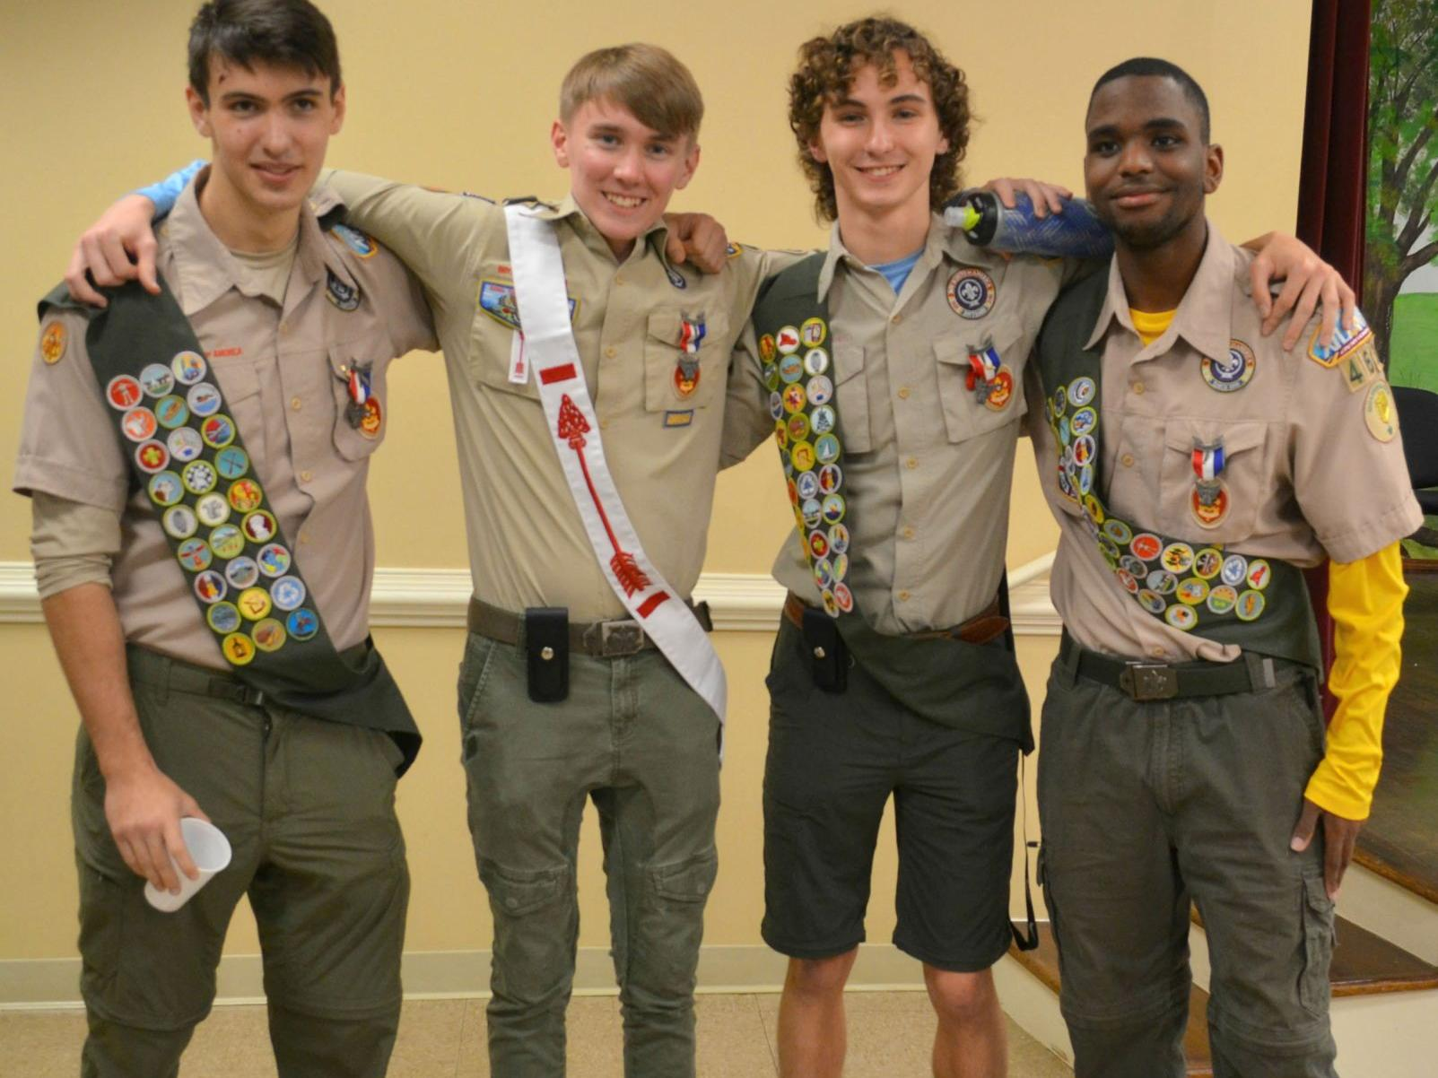
NSNA BTN ToolKit
https://www.nsna.org/breakthrough-to-nursing-committee.html
Goes over:
Overview of what Breakthrough to Nursing is and its history
How to get BTN programs started at the chapter level
Activity ideas (with step-by-step instructions!)
Monthly award topics and deadlines for 2022-2023
Resource guide for prospective nursing students
Contact information to get in touch with other Breakthrough to Nursing committee members nationwide!

Slide 35
Ice Breaker: Pictionary Charades
Each person will be allowed to draw anything of their choosing on the board (not too obscure!). The person who correctly guesses the most drawings wins a prize!

Slide 36
Director at Large
I’m from a small town in SouthWest VA called Dublin. If you blink, you would miss it
I’m a senior at Radford University graduating this December
I'm the community service chair in our Student Nurse Organization
I’m also President and founder of a club called the Global and Local Outreach Education Club
I’m a mom to a 5 year old named Emma
I have accepted a job at Roanoke Memorial Hospital in the Medical Surgical Department with plans to begins my masters degree in the Spring so I can become a nursing professor

Slide 37
Duties and Responsibilities
Assists the 1st Vice President in the planning of the Annual Convention
Assists the Torch editor
Assist the other members with anything that they may need to make their jobs easier

Slide 38
VNSA Annual Convention
Theme: Nursing = LeaRNing
Date: February 25th, 2022 (tentative)
Location: University of Virginia (UVA)
Charlottesville, VA
Why you should come!
Opportunity for VNSA members to network, learn, and develop themselves professionally
Breakout sessions, keynote and endnote speakers, exhibitors
Election of new officers for the upcoming year

Slide 39
NSNA Annual Convention
Thousands of nursing students, faculty, and leaders across the country
Keynote and endnote speakers, exhibit hall, focus sessions, awards ceremony
NCLEX review and many networking opportunities
School and State chapters represented in the House of Delegates- resolutions are debated and new BOD for NSNA are elected
Upcoming NSNA Annual Convention
Nashville, Tennessee
April 12th - 16th, 2023

Slide 40
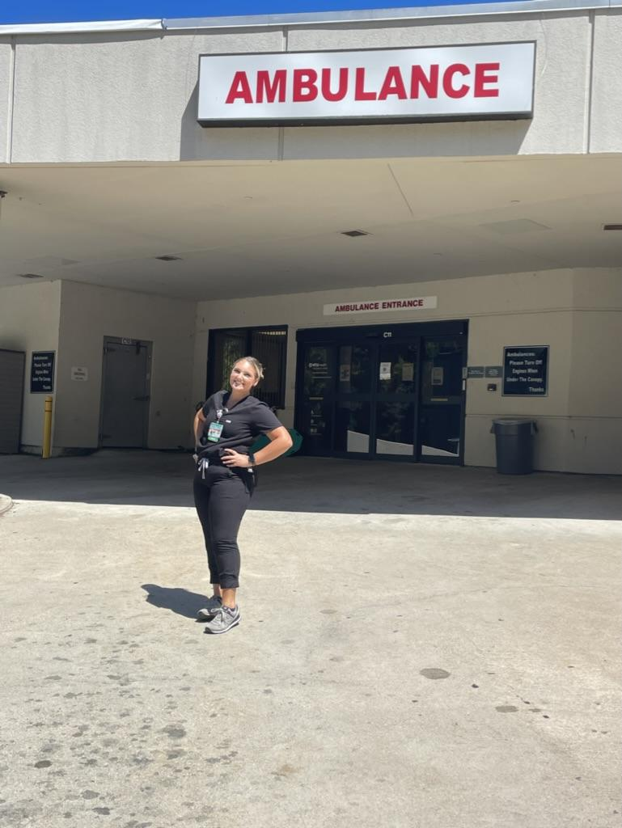
Nomination and Elections
I am from King William, VA not far from Richmond!
I am a Junior at Randolph-Macon College, in Ashland, Va.
At RMC, I serve as our SNA 1st Vice President.
I currently work as a Patient Care Tech in the ER at VCU Tappahannock!
Post-graduation I really would like to stay in the ER or maybe go to higher trauma center but I also really enjoy surgery!! Once I graduate I am very interested in going back to school to earn my MSN and DNP!
Besides nursing I really love my school and what we are able to offer and i also really enjoy my sorority.
An interesting fact about me is that my family owns an Italian Restaurant that I work at!

Slide 41
Nomination and Elections
I am responsible for organizing and running elections at the VNSA Annual State Convention
I work with the president, vice president and advisors to go over the applications
We vote as a whole board on the members and their positions they are applying for
To Apply: go to the application on the website, it is very easy and simple!!
Benefits of joining VNSA exec is that I have been able to be involved at the state level and better my leadership skills!!

Slide 42
Policies and Initiatives Director: About Me
From Bumpass, VA
Youngest of 4
Live on a farm :)
Senior at Randolph-Macon College
Double Majoring
Captain of Women’s Swim Team
Graduating in May!
President of R-MC SNA
Excited for us to be involved with VNSA!

Slide 43
Policies and Initiatives Director
Position Duties and Responsibilities
Responsible for informing constituent associations of matters pertaining to resolutions.
Virtual VNA Legislative Summit
No VNA Legislative dinner, Summit is on November 15th (also will be available to view through March 31st).
Talking about legislative solutions for strengthening the nursing workforce, increasing access to care, and securing full practice authority
https://virginianurses.com/page/LegislativeSummit
Registration by November 13th
$59 for VNA Members, Lcardwell@virginianurses.com for group pricing
Apart of my role in bylaws, anyway to be paid for through VNSA?

Slide 44
Policies and Initiatives Continued
VNA Successful Legislation 2022
$1 million for the APRN Virginia Preceptor Incentive Program ● $1 million to fund nursing scholarship programs at VDH ● $2.4 million for the State Loan Repayment Program for Healthcare Workers ● $2 million to capitalize a Virginia Health Workforce Development Fund pursuant to the provisions of HB191, and funding to create an Advisor to the Governor for Healthcare Workforce ● Increased reimbursement rates for medicaid providers ● Increased tuition assistance grants for graduate level students seeking degrees in healthcare ● A study by the State Council of Higher Education for Virginia to review nursing needs and barriers to nursing education to address workforce shortages.

Slide 45
Policies and Initiatives Continued
Law Resolution Process
The 2023 General Assembly Session will begin on Sunday, January 8, 2023, and conclude on Friday, February 24 (adjournment sine die is Saturday, February 25). The 2023 Session will convene at 12 noon on Wednesday, January 11, 2023. Live streams!
Topics Include Advancing Full Practice Authority, Strengthening the Nursing Workforce, Increasing Access to Care
How we can contribute? What legislation items do you have? Contacted the local chapter president of Central VA.
Voting in Elections
Nominations and Elections: Rosalina Volo
Anything I can do to help let me know!

Slide 46
Questions/Comments?

Slide 47
Final Ice Breaker!
How many pumpkins were in this powerpoint? (includes this pumpkin)
Closest guess wins the final prize!
Notes:
21

